Slide 1
Course
AWS Cloud Practitioner
MaxCloud

Slide 2
01
Class
Cloud basic concepts
AWS Global Infrastructure
Cloud Economy Concepts

Slide 3
Introduction
Cloud computing is the on-demand delivery of compute power, database, storage, applications, and other IT resources through a cloud services platform through the internet with pay-as-you-go pricing.
Traditionally, a developer looking to build an application had to procure, set up, and maintain physical infrastructure and the application. This is where cloud computing comes in.
A cloud services platform provides rapid access to flexible and low-cost IT resources that you can use to build and maintain software and databases, and create applications to delight customers.
You don’t need to make large upfront investments in hardware and spend a lot of time on the heavy lifting of managing that hardware. You can access as many resources as you need, almost instantly, and only pay for what you use.

Slide 4
Six advantages of cloud computing
Pay as you go - Pay only when you use computing resources, and only for how much you use.
Benefit from massive economies of scale - AWS aggregates usage from hundreds of thousands of customers in the cloud, which leads to higher economies of scale. This translates into lower pay-as-you-go prices.
Stop guessing capacity - When you make a capacity decision prior to deploying an application, you often end up either sitting on expensive idle resources or dealing with limited capacity. With cloud computing, you can access as much or as little capacity as you need, and scale up and down as required with only a few minutes notice.
Increase speed and agility - IT resources are only a click away, which means that you reduce the time to make resources available to your developers from weeks to minutes. This dramatically increases agility for the organization, because the cost and time it takes to experiment and develop is significantly lower.
Realize cost savings - Companies can focus on projects that differentiate their business instead of maintaining data centers. With cloud computing, you can focus on your customers, rather than on the heavy lifting of racking, stacking, and powering physical infrastructure.
Go global in minutes - Applications can be deployed in multiple Regions around the world with a few clicks. This means that you can provide lower latency and a better experience for your customers at a minimal cost.

Slide 5
On-premise vs Cloud costs
On-premise costs
Hardware costs
Software costs
Maintenance/support contract costs
Operations staff costs
Cloud costs
Pay as you go

Slide 6
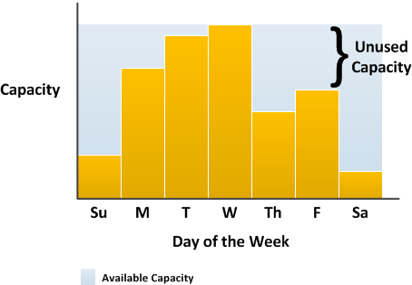
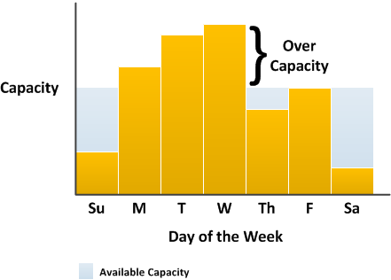
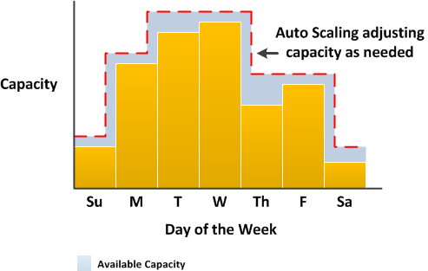
Understanding the concept of rightsizing

Slide 7
Understanding the role of fixed costs compared with variable costs
The cloud allows you to trade fixed expenses (such as data centers and physical servers) for variable expenses, and only pay for IT as you consume it. And, because of the economies of scale, the variable expenses are much lower than what you would pay to do it yourself.

Slide 8
Performance characteristics
Scalability - Scalability refers to the ability of a system to handle increasing amounts of workload or traffic by adding more resources such as servers, storage, or network bandwidth
Elasticity - Elasticity is similar to scalability, but it also implies the ability to dynamically adjust resources in response to changing demand.
High Availability - High availability refers to the ability of a system to remain operational and accessible even in the face of component failures or other disruptions.
Agility - Agility refers to the ability of a system to rapidly adapt to changing business needs or requirements.

Slide 9
Cloud computing deployment models
On-premises - The deployment of resources on-premises, using virtualization and resource management tools, is sometimes called the private cloud.
Cloud - A cloud-based application is fully deployed in the cloud and all parts of the application run in the cloud.
Hybrid - A hybrid deployment is a way to connect infrastructure and applications between cloud-based resources and existing resources that are not located in the cloud.

Slide 10
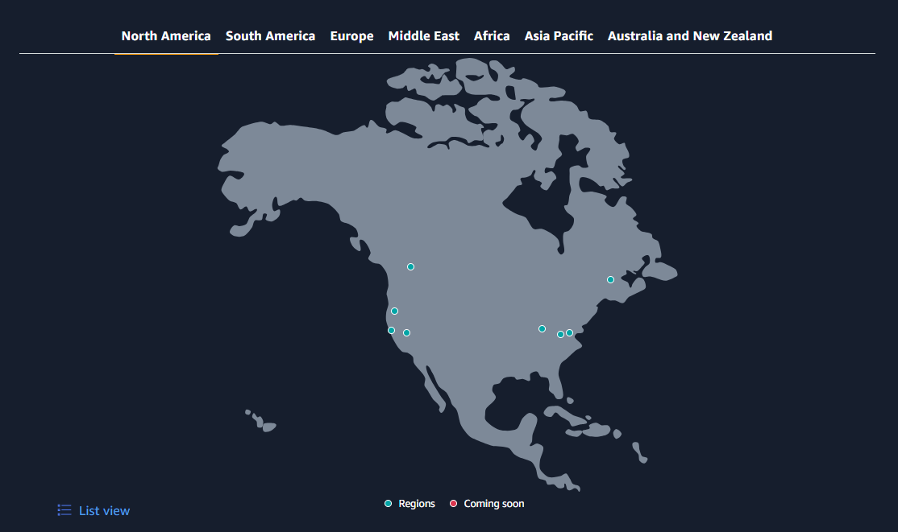
AWS Global infrastructure
Notes:
https://aws.amazon.com/about-aws/global-infrastructure/regions_az/

Slide 11
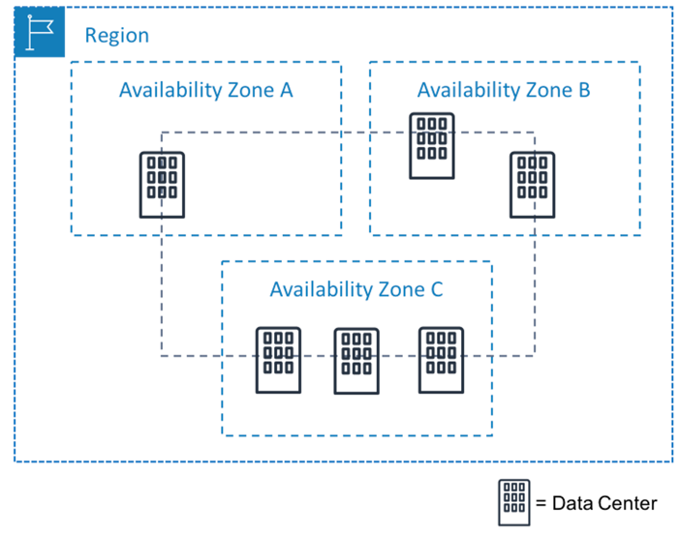
AWS Regions and Availability Zones
Notes:
https://aws.amazon.com/about-aws/global-infrastructure/regions_az/

Slide 12
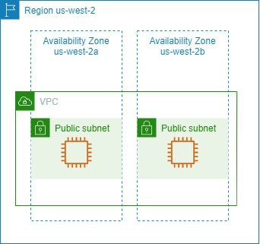
High availability in AWS
Notes:
https://aws.amazon.com/about-aws/global-infrastructure/regions_az/

Slide 13

High availability in AWS (Failure)
Notes:
https://aws.amazon.com/about-aws/global-infrastructure/regions_az/

Slide 14
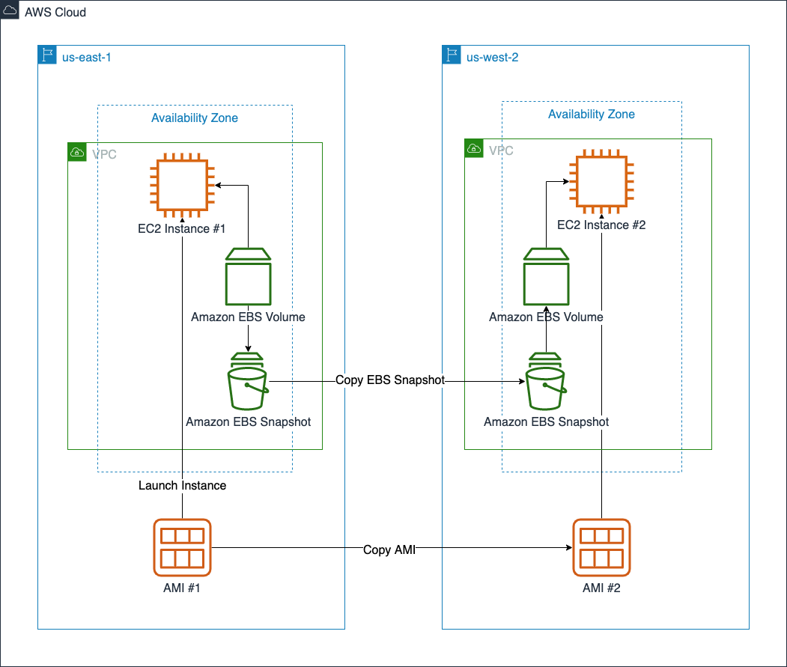
Multi-region architecture
Disaster recovery
Low latency for end users
Data sovereignty
Notes:
https://aws.amazon.com/about-aws/global-infrastructure/regions_az/

Slide 15
Multi-region architecture
Disaster recovery
Low latency for end users
Data sovereignty
Notes:
https://aws.amazon.com/about-aws/global-infrastructure/regions_az/

Slide 16
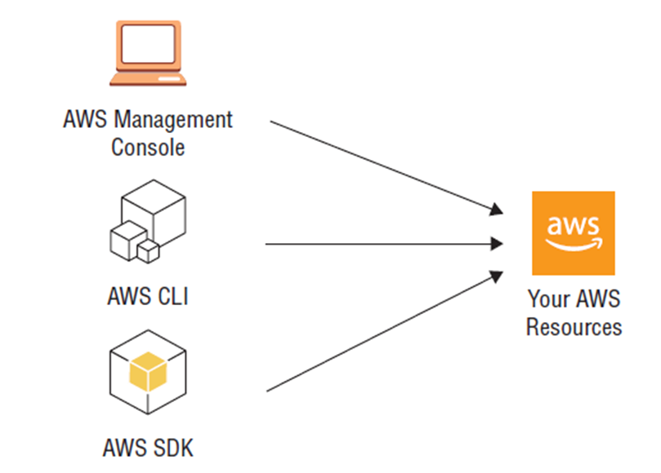
Interact with AWS
Notes:
https://aws.amazon.com/about-aws/global-infrastructure/regions_az/

Slide 17
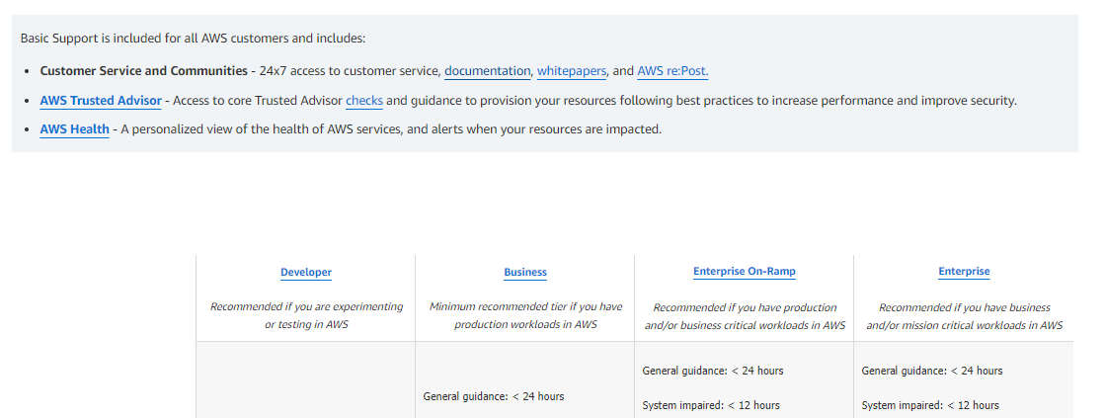
AWS Support plans
https://aws.amazon.com/premiumsupport/plans/
Notes:
https://aws.amazon.com/about-aws/global-infrastructure/regions_az/

Slide 18
Licencing options
License Included
In the License Included model, the software license is made available by AWS, so you don't have to purchase your own license separately.
BYOL
The Bring Your Own License (BYOL) model is intended for customers who prefer to use their existing licenses or purchase new licenses.

Slide 19





Managed AWS services
Managed AWS Services
Kubernetes
Amazon EKS (Elastic Kubernetes Service)
PostgreSQL
Amazon RDS (Relational Database Service)
Some services are AWS native
Amazon ECS (Elastic Container Service)

Slide 20
AWS Free Tier
12-Months Free: These free tier offers are only available to new AWS customers, and are available for 12 months following your AWS sign-up date. When your 12 month free usage term expires or if your application use exceeds the tiers, you simply pay standard, pay-as-you-go service rates.
Always Free: These free tier offers do not automatically expire at the end of your 12 month AWS Free Tier term, but are available to both existing and new AWS customers indefinitely.
Trials: These free tier offers are short term trial offers that start from the time of first usage begins. Once the trial period expires you simply pay standard, pay-as-you-go service rates (see each service page for full pricing details).
https://aws.amazon.com/free/

Slide 21
Muchas Gracias

